Slide 1
Online ordering system
- Product overview -

Slide 2
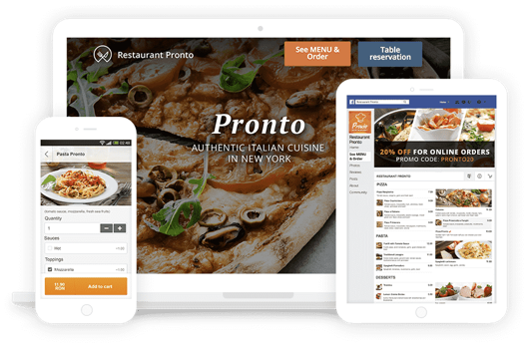
Complete online ordering solution
Allow your customers to order from your website, Facebook page and mobile app.
Allow your customers to book a table from your website and mobile app.
Easy to integrate and compatible with all popular website builders.

Slide 3
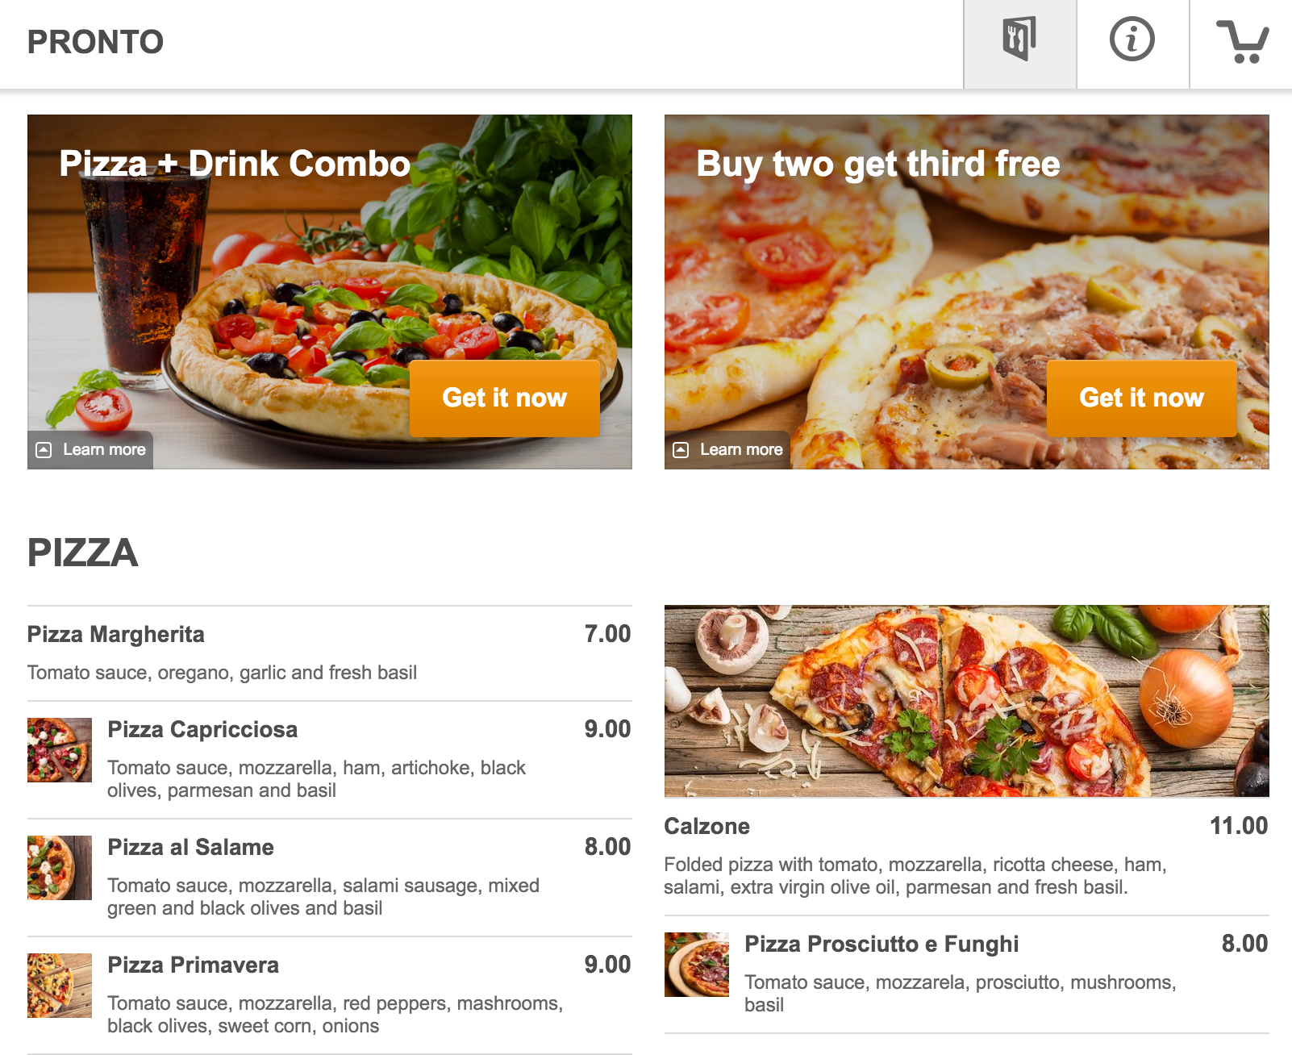
Online menu
Designed to stimulate appetite and increase sales.
Flexible and easy to maintains and set up.

Slide 4
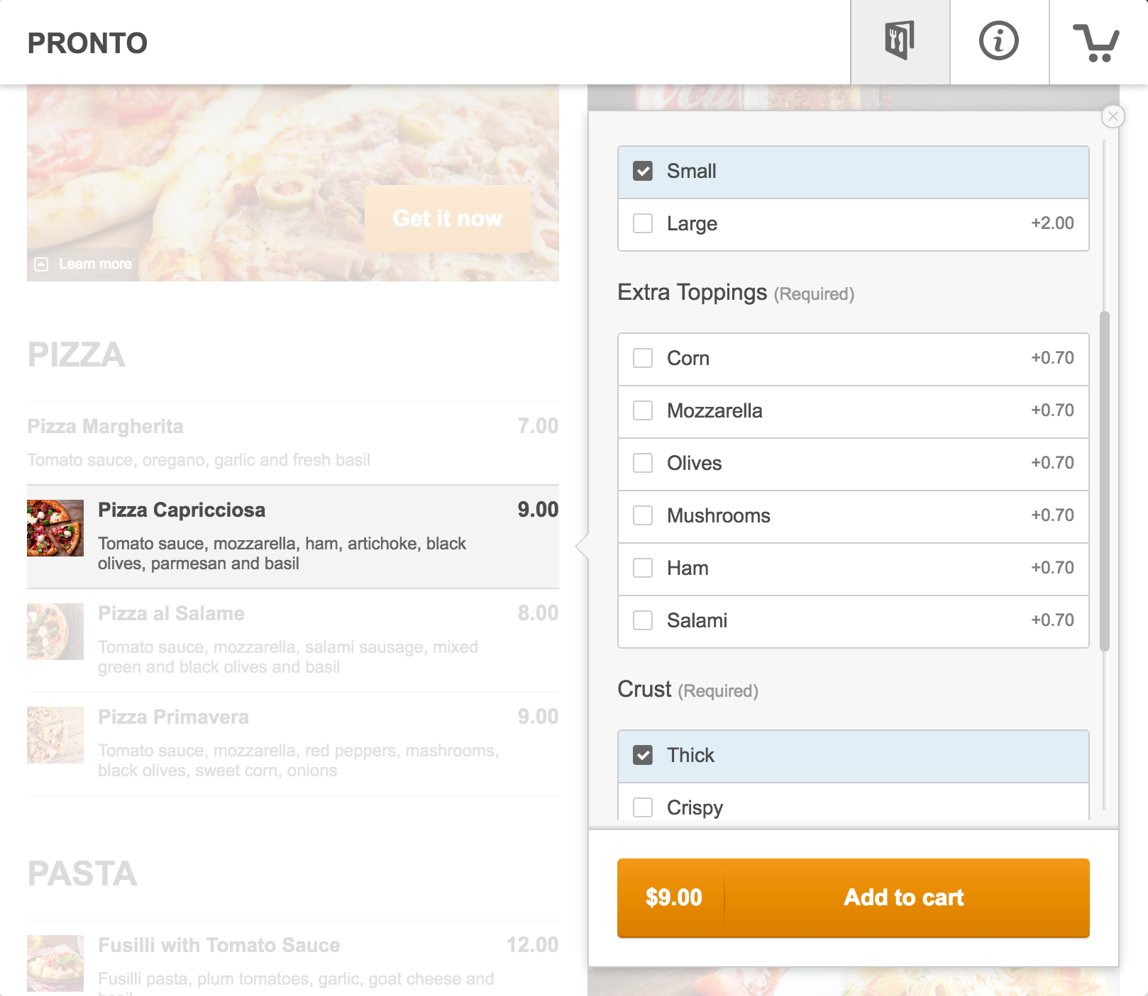
Order customization
Choices and add-ons keep your menu compact and well organized.
They are also the easiest way to up-sell.

Slide 5
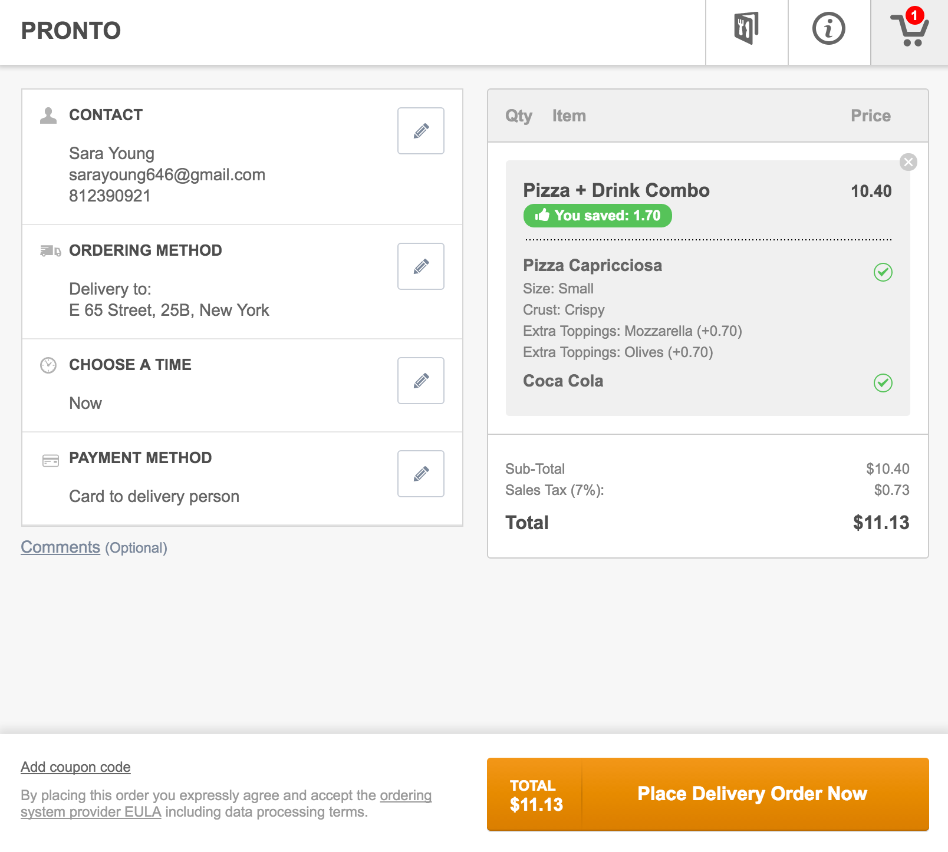
Checkout
One page checkout, optimized to increase conversion.
Data pre-filled for returning clients.
No account required.

Slide 6
Real time confirmation
Your client holds the line while you review the order.
Waiting is entertaining with useful messages.

Slide 7
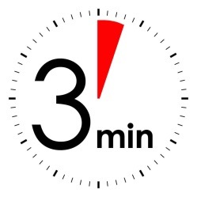
Ringing like a telephone
In real-time, right at the restaurant

Slide 8
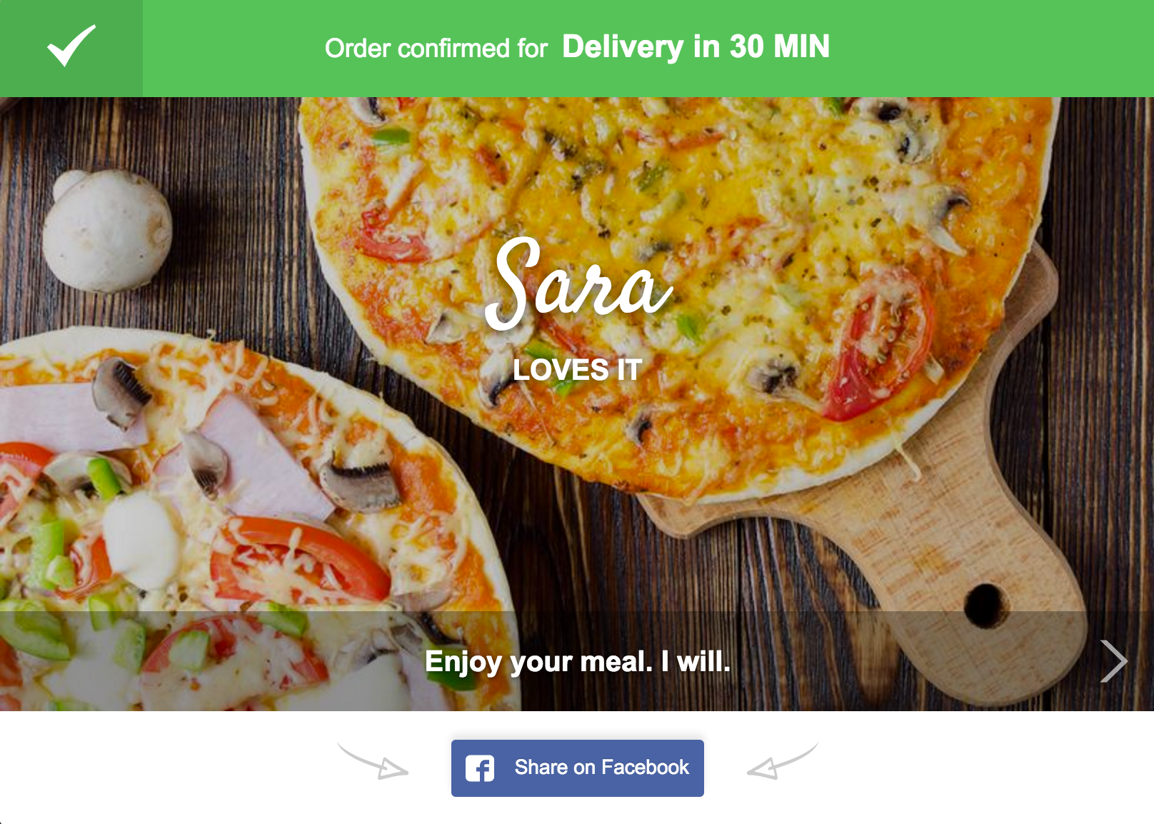
Why clients love it
Convenient
No busy lines
No misunderstandings
Fast order confirmation
No follow up calls
No waiting in vain

Slide 9
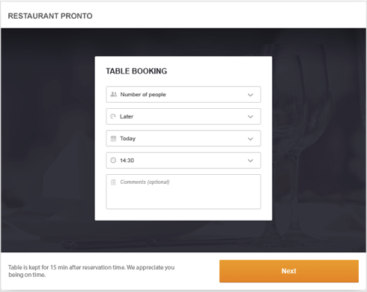
Table reservations
Easy to use table reservations widget.
Possibility to order in advance.
All reservations are received and confirmed in real time with the restaurant app.

Slide 10
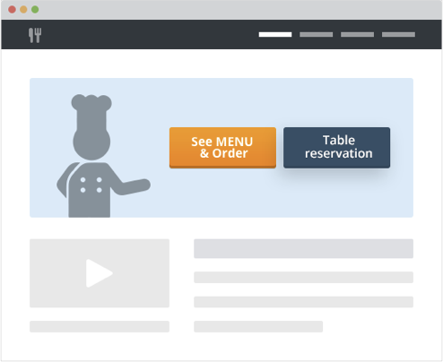
How it works
Simply add the See MENU & Order button on your website and Facebook page. When clicked, it opens the online menu.
Similarly, the Table Reservation button on you website opens the booking form.

Slide 11
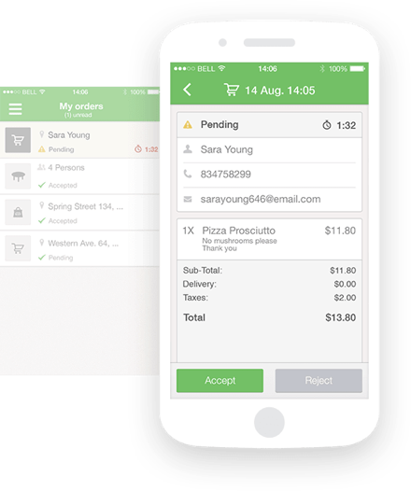
App for taking orders & reservations
You receive the orders and table bookings on a smartphone or tablet (Android or iOS).
You have 3 minutes to confirm the order / reservation.
Orders can be printed directly from the app.

Slide 12
Prerequisites
One dedicated smartphone or tablet (Android or iOS) for taking online orders and reservations (per restaurant location).
Permanent internet connection for the order taking device.

Slide 13
How to set it up
Anyone can do it within minutes:
Create your restaurant profile (15 minutes)
Install the order taking app (1 minute)
Publish the See Menu & Order and Table Reservation buttons (1 minute)

Slide 14
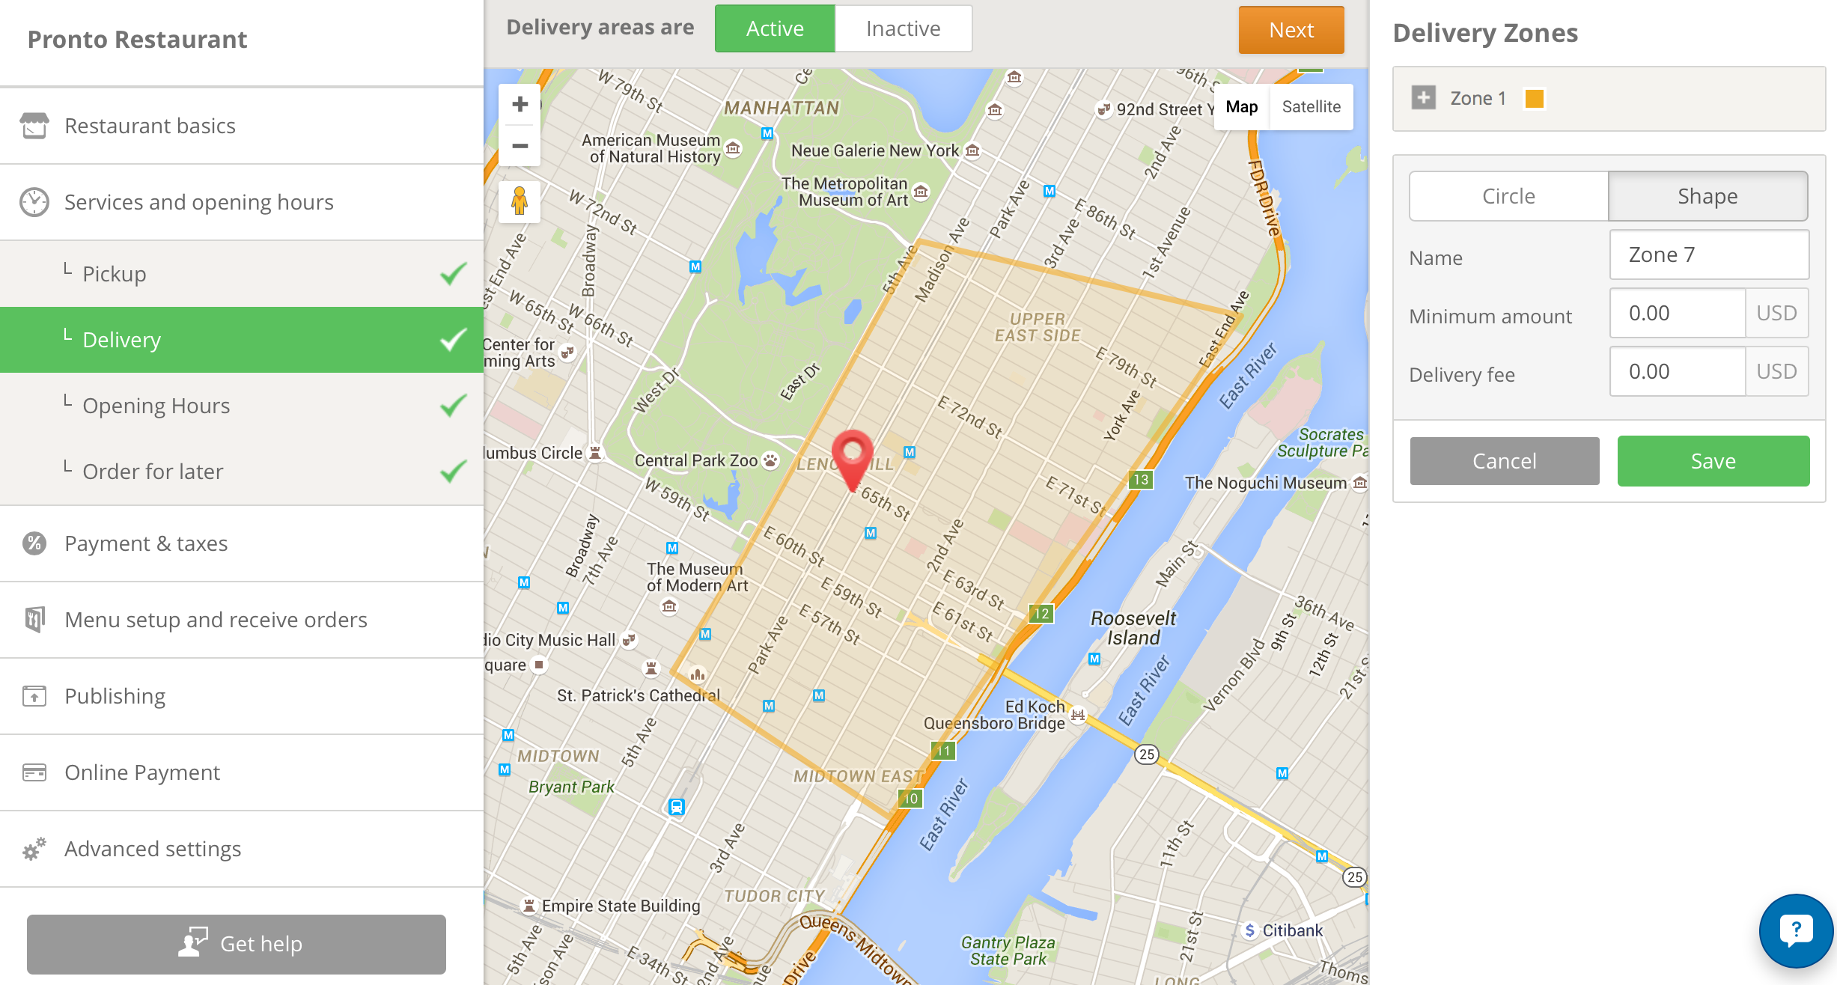
Admin Panel - Highlights
The most restaurant-friendly ordering system.

Slide 15
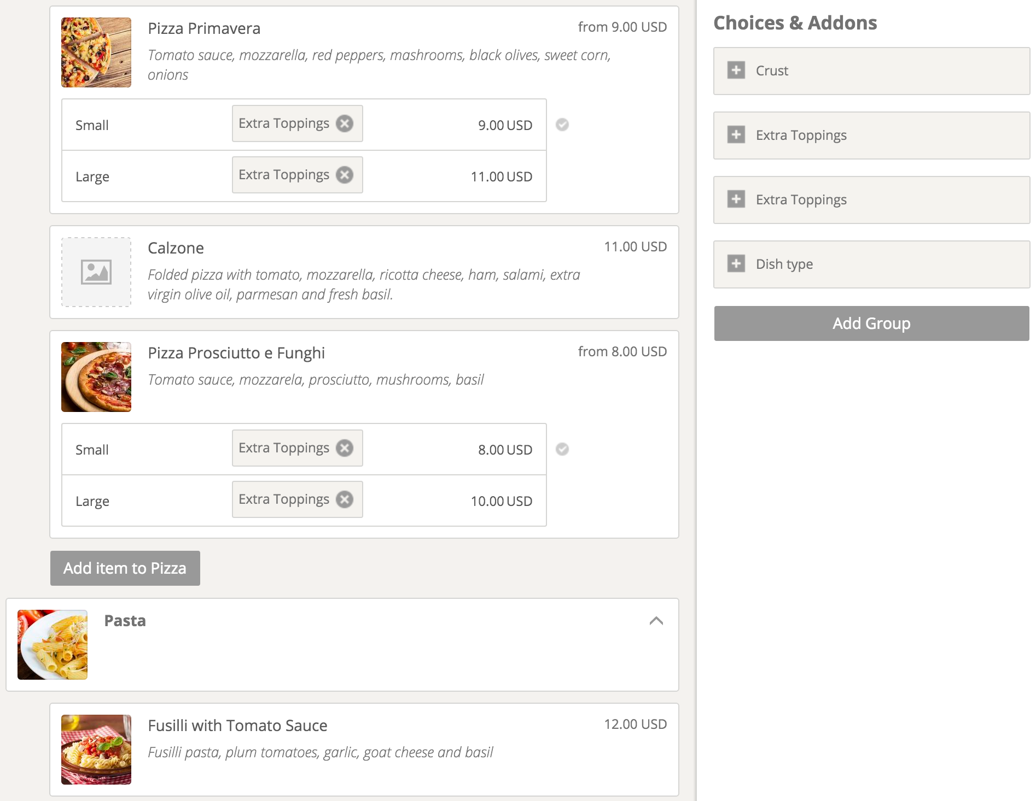
The menu editor
Free stock of images available for you.
Reusable choices and add-ons.
Drag & drop elements to reposition them.

Slide 16
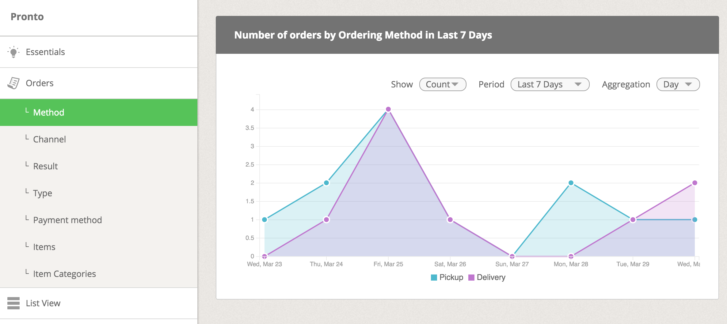
Reporting module
Your business in numbers: orders stats, delivery heat-map and more

Slide 17
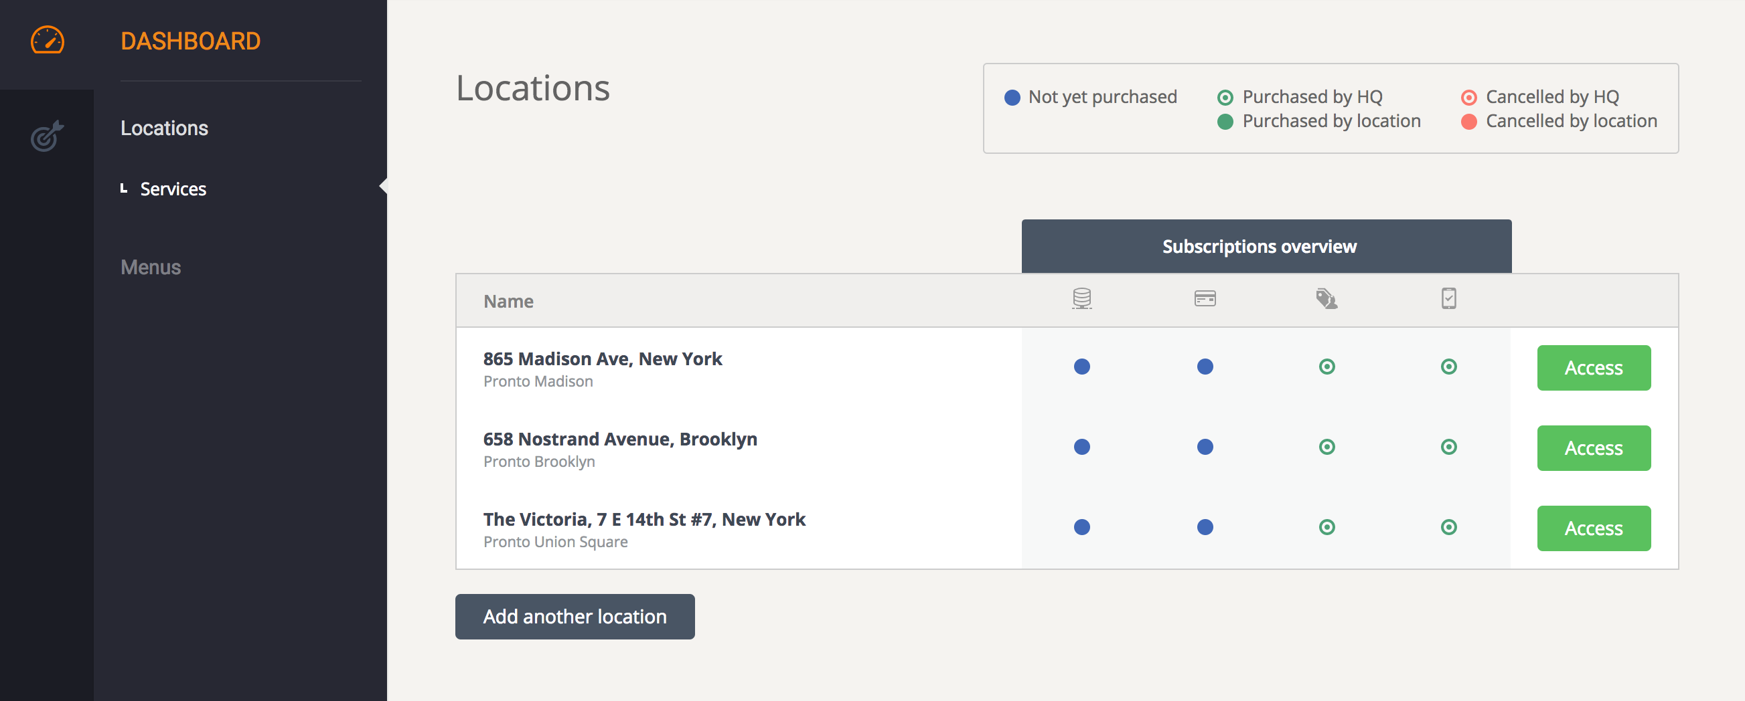
Multi-location support
Manage multiple locations from the same account.
Share menus and promotions between locations.

Slide 18
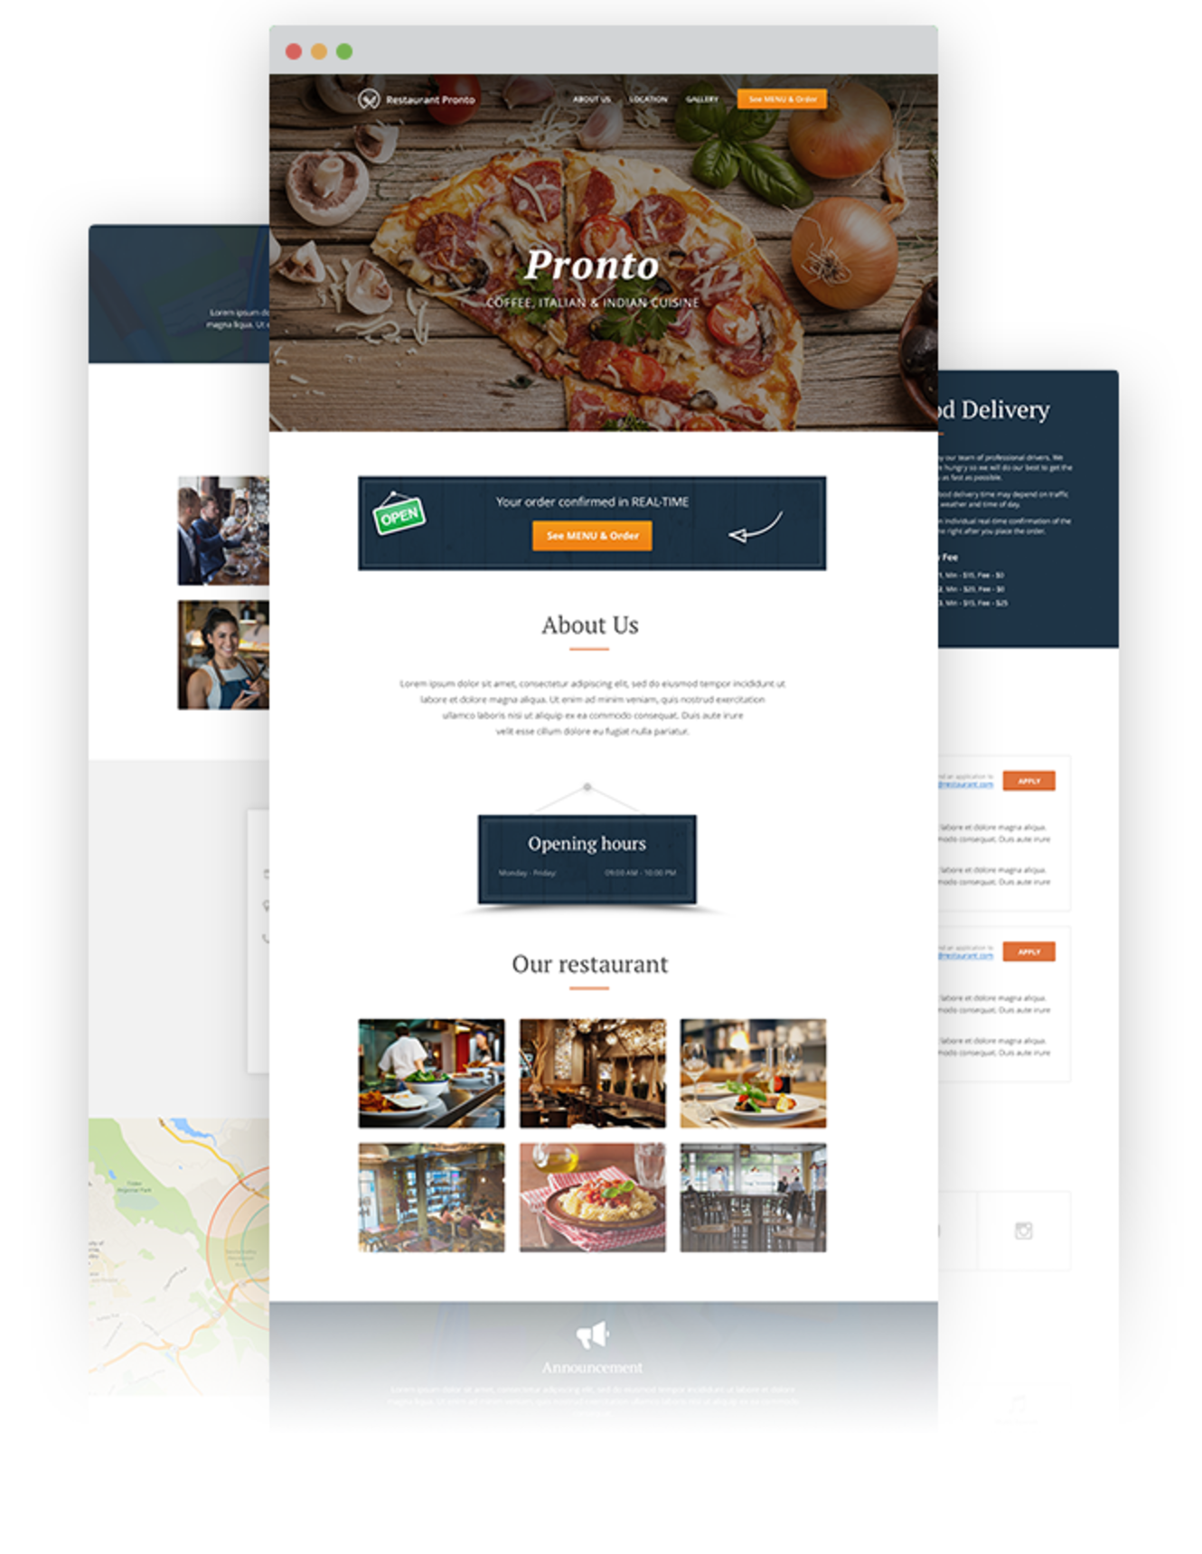
The sales optimized website (optional)
Instantly generate your own personalized website.
Optimized for search engines.
Available with a new or existing domain.

Slide 19
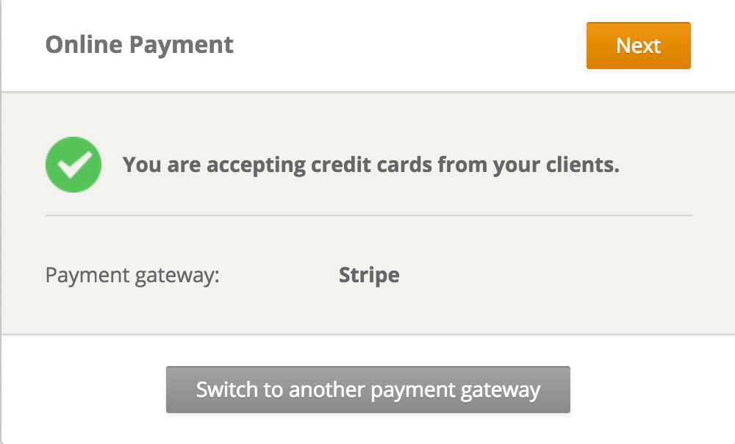
Online payments (optional)
Activate online payments and cash directly into your merchant account.
You have several payment gateways to choose from.
Note: The availability of some paid features depends on the availability of certain infrastructure providers in the region. We always recommend to check in the admin area which advanced features work for each specific restaurant account setup.

Slide 20
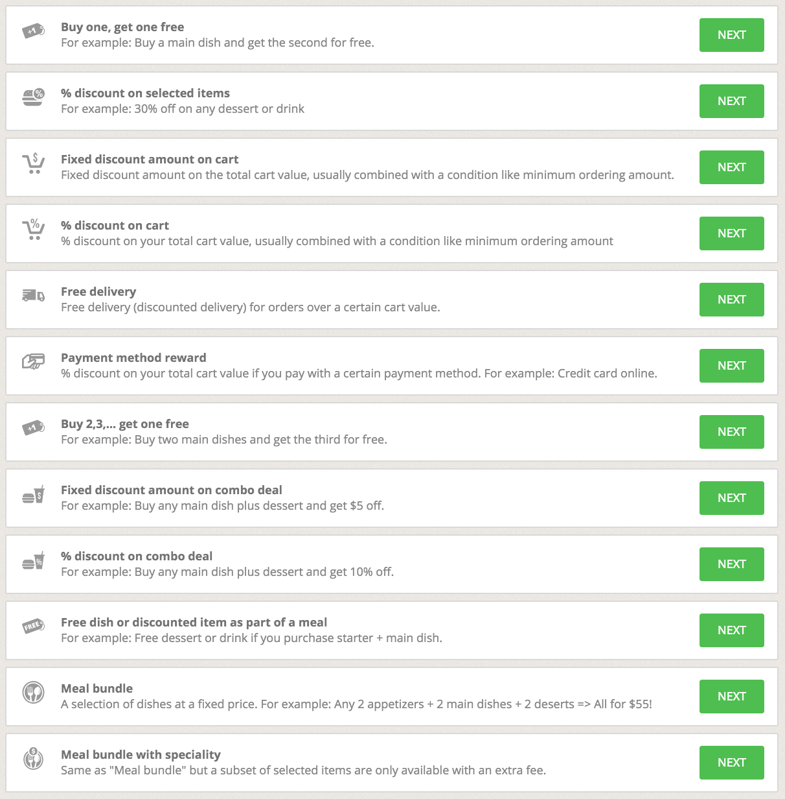
Promotion engine
Set up almost any promotion logic you can think of
Promo templates and countless ways to segment your clients
Run multiple promotions simultaneously (optional).

Slide 21
Ordering apps for food clients
Find restaurants nearby based on location
In-app food ordering and paying
The FoodBooking Club

Slide 22
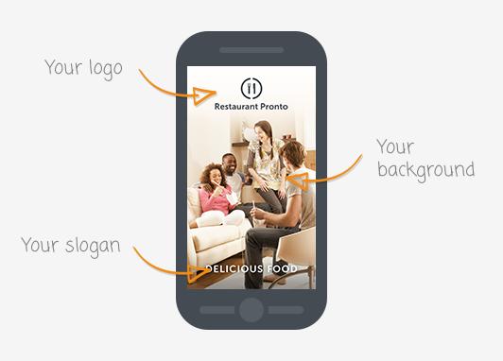
Branded Mobile App (optional)
Features only one restaurant brand with all its locations.
Customizable to reflect your brand

Slide 23
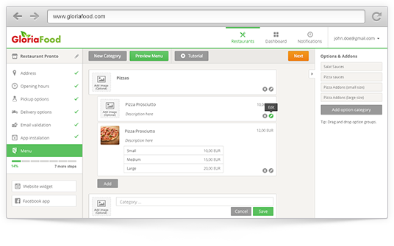
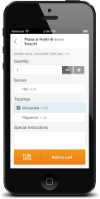
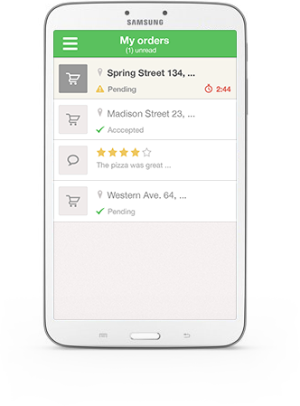

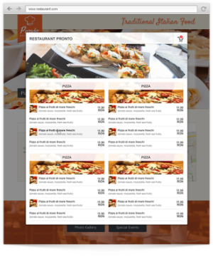
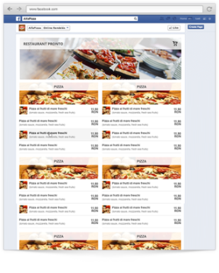
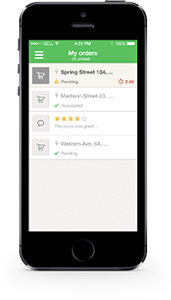
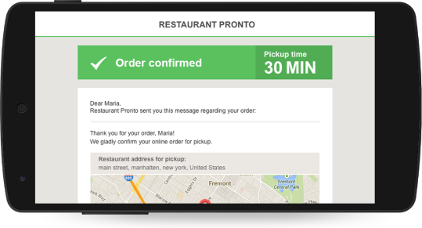

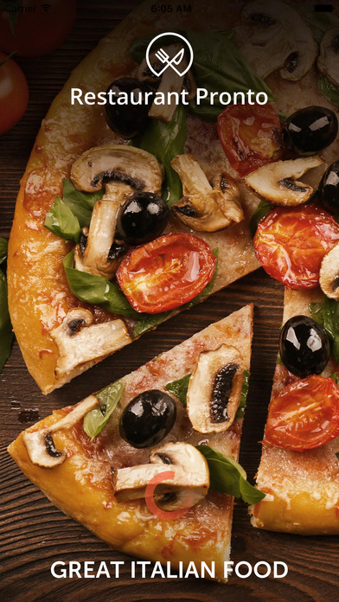
www.restaurantlogin.com
Mobile Web
Widget
Android Order Taking App
Self Service
Admin Panel
Desktop Web
Widget
Read & save configuration relevant data to database
Heartbeat
Push orders to the order taking app
Update delivery & pickup time.
Get restaurant & menu info
Receives new orders.
iOS Order
Taking App
Core logic
Facebook App
Email engine
Emails
Android & iOS
Client app
Android & iOS
branded app

