Slide 1

The Menu Engineering Trilogy
Tips & Secrets That Will Boost Your Restaurant Sales

Slide 2
TABLE OF CONTENTS
THE MENU ENGINEERING TRILOGY
4 Expert Menu Design Tips that Will Boost Your Sales
6 Menu Pricing Methods: Erase the Pain of Paying with Menu Psychology
3 Secret Menu Writing Tips: The BEST Food Descriptions that Make You Hungry

Slide 3
4 Menu Design Tips That will Boost Your Sales
PART 1

Slide 4
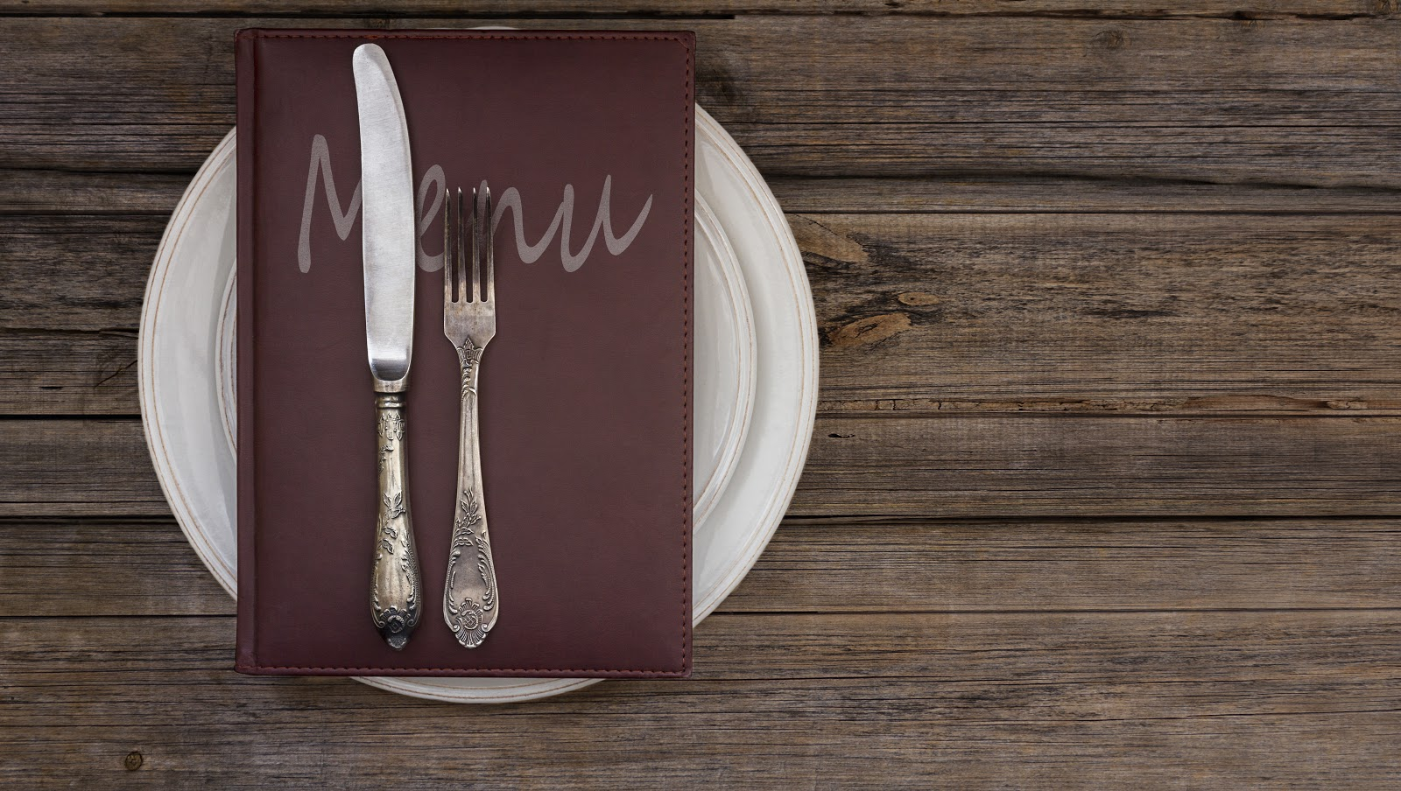
Getting Into Your Client’s Head Using Menu Design Tips
Finding the easiest way to increase restaurant sales can sometimes turn into a hassle. But it doesn't have to be. Because the answer is right in front of you.
Intrigued? You'd better be.
Advantages of menu engineering: did you know that you can use restaurant menu engineering tips to actually squeeze a 30% higher revenue out of your current menu… just as easy as taking candy from a baby?
But what is menu engineering? What does it entail?
It refers to combining restaurant menu design tips with menu psychology to stimulate your clients' appetite and encourage them to spend more.
- Menu Engineering Trilogy -

Slide 5
It’s like extending your arm to pick the juicy, low hanging fruit. And in your case, that low hanging fruit is an extra profit that is out for grabs.
And the crazy part is that implementing these menu engineering tips is something that you can easily do within a very short period of time; and the results can be seen almost instantly.
Yet, less than 40% of restaurant owners actually take advantage of the following menu design tips to craft a deeply persuasive menu that will stimulate their clients into ordering more food.
So then... how to do menu engineering?
Well, all you need to do is just use the following design related tricks, to craft a deeply persuasive menu.
Such a menu is filled with visual triggers that will stimulate your clients into ordering more food.That’s the goal, right?
Remember, the majority of your clients are as hungry as a bear when they first see your menu. So make sure to tap into that opportunity everytime the situation presents itself:
-> Menu Engineering Formulas Based on Powerful Restaurant Menu Design Tips <-
Menu Design Tip #1:
Cross-selling: Provide Them with Additional Food Options
Do you remember the famous McDonalds saying “Would you like fries with that?”
You have to give McDonalds credit for inventing cross-selling, which is one of the greatest marketing concepts of all time.
Since the purpose is to get your client to order more food - and spending big time - providing him with additional and related products will certainly do the trick.
All crafty marketers actually use this technique to sell you something, whether it’s McDonald’s fries or that extended warranty for your fancy new phone or TV of yours.
- Menu Engineering Trilogy -

Slide 6
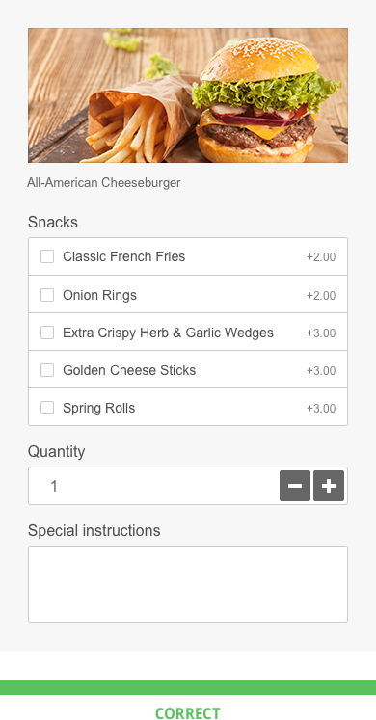
And they’re successful because they make you feel that you need that extra additional product. And sometimes our needs intertwine with our wants.
So that’s exactly what you should do - give your clients the chance to add...
extra snacks, like french fries
extra pizza toppings
or/and provide them with some of your most delicious dessert options
They want what you show them. So give the people what they want. (See what I did there?)
Menu Engineering Tactic #1:
Cross-selling: Provide Them with Additional Food Options

Slide 7
Menu Design Tip #2:
Add Vivid Imagery to Your Menu
Having some great looking images accompanying your food items on your menu has the potential to increase restaurant sales by 30% nonetheless.
Researchers at the Iowa State University tested a digital display of a salad on kids at a YMCA camp. They discovered that those who saw the salad image were up to 70% more likely to order a salad for lunch.
Here’s the interesting take that should stick with you:
“You respond to the image on the display like you would respond to a plate in front of you.
If you’re hungry you respond by saying, ‘I’ll have what’s in that picture.’
Fast food chains have already employed this tactic. They use digital menu boards to entice their customers into ordering the food items with the highest rate of profitability.
It’s a smart strategy to boost your sales.
“
“The more vivid the image, in terms of movement, color and accuracy of representation, the more realistic, the more it’s going to stimulate your response to it.”
(Brian Mennecke, Associate Professor of Information Systems, Iowa State University)
- Menu Engineering Trilogy -

Slide 8
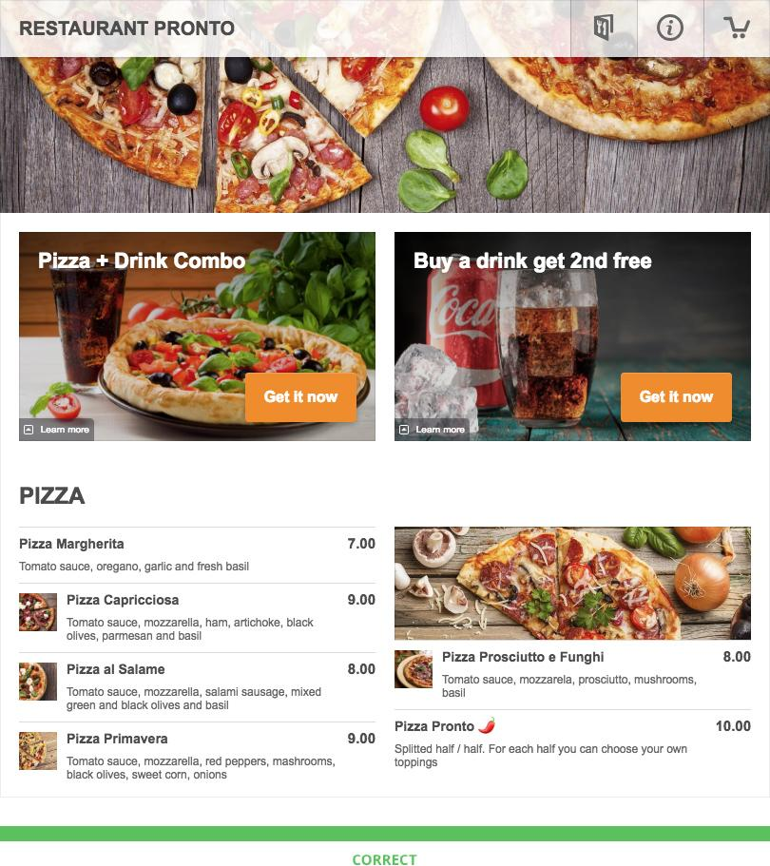
Menu Engineering Tactic #2:
Add Vivid Imagery to Your Menu
- Menu Engineering Trilogy -

Slide 9
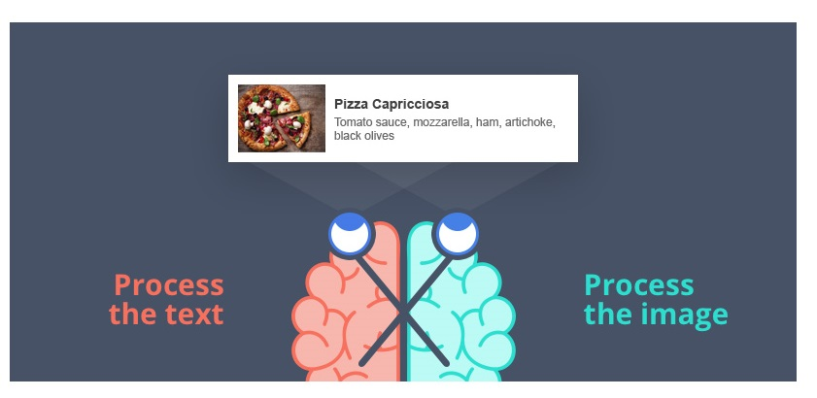
Menu Design Tip #3:
Place Most of the Visual Content on the Left Side of Your Menu
The right hemisphere is in charge of our more creative side. Which means that it is our right side hemisphere that helps us process images. Or any type of graphic content for that matter.
However, what few people know is that the right side of the brain is responsible for controlling the left side of the body.
And there’s more.
Due to this in-built neuroanatomical structure, the right hemisphere can best process images when they’re located on the left side of the menu:
“…a stimulus presented in the left visual field (LVF) is initially received and processed by the right hemisphere (RH), and a stimulus presented in the right visual field (RVF) is initially projected to and processed by the left hemisphere (LH)…” (Bourne, 2006, pp. 374)
- Menu Engineering Trilogy -

Slide 10
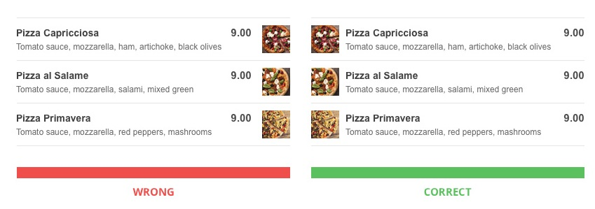
So when you show your client an ad that his tired mind is able to process extremely fast, then this produces an enjoyable sensation in his brain. And he attributes it to the menu that’s currently sitting in front of him.
According to Alter & Oppenheimer, 2009, when you place images and graphics on the left side of your ad, you increase processing fluency.
This refers to the ease and speed with which our brains process information.
But why is this important?
Well, in this day and age, we are constantly bombarded by a lot of things that drain us of energy:
working,
planning,
paying the bills,
taking care of your family,
etc.
And sometimes your brain needs a break from all these things that tire and put a strain on him.
So, in other words, by placing most of your menu images on the left side, your customers will be able to process your promotional materials quicker.
Menu Engineering Tactic #3:
Place Most of the Visual Content on the Left Side of Your Menu
- Menu Engineering Trilogy -

Slide 11
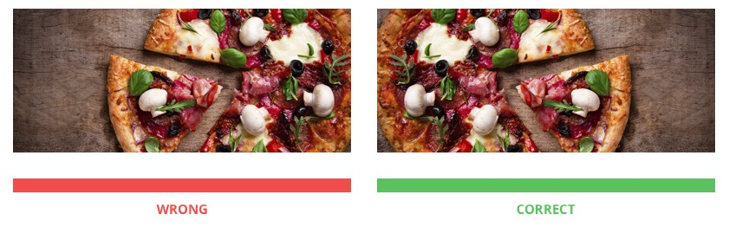
Menu Design Tip #4:
Menu Item Placement -> Position the Products in a Way that Stimulates Mental Interaction
Menu item placement matters. Ok, so what does that mean?
Well, in layman’s term, this tactic encourages your client’s mental interaction with the product that you’re selling.
It helps him visualize eating your food.
Take a look at the two mouth-watering images below. Although they’re the same, the one on the right will seem more appealing to your right-hand customers.
Because it will help your customers see themselves grabbing a slice of that hot pizza slice with dripping mozzarella.
Menu Engineering Tactic #4:
Position the Products in a Way that Stimulates Mental Interaction
The second part of the Menu Engineering Trilogy reveals 7 incredible menu pricing tactics. These will help fill your customer’s plate with even more food…
... while making him forget all about the pain of paying.
- Menu Engineering Trilogy -

Slide 12
6 Menu Pricing Methods: Erase the Pain of Paying with Menu Psychology
PART 2

Slide 13

Getting Into Your Client’s Head Using Psychological Tips
What came first, the chicken or the egg?
It’s an annoying and funny question at the same time, which sparks a never-ending controversy.
Yet, what nobody can actually deny is that you can’t have one without the other, right? There’s no chicken without the egg, and vice versa. So where am I heading with this analogy?
Well, similarly, when your clients order food from you, they want to order as much food as possible, yet they’re afraid of the horrid consequence:
having to give away a lot of money from their paycheck to pay for their meal
- Menu Engineering Trilogy -

Slide 14
And nobody wants that, for sure.
So then the following question arises: how can you get them to order more food from you without thinking about the price?
Hmmm... What to do, what to do?
Well, that’s where the power of menu engineering comes into play and saves the day, yet once again.
See, marketers didn’t just use secret psychological tricks to persuade more of their clients into buying more food. They’ve also done it to alleviate their clients’ existing pain of paying.
This type of fear can actually be traced back to one of the primary needs of the human being: the fear of loss (an innate, primary need).
The fear of losing their money is what makes them tick and pushes them towards taking some sort of action. However, in 99.9% of the cases, it’s NOT the one that you want them to.
The fear of overpaying can actually make your customers hit the brakes and curb their desire of eating overpriced foods or ordering multiple dishes.
And this fear is quite possibly YOUR clients’ biggest pain point when ordering food online or dining out.
So what you need to be doing is actually make them think: “Wallet? What wallet?”
But how can you do that?
The solution? Counteract their fear of losing money and appeal to their wish to acquire bargains (the learned or secondary need)... since everyone likes a good deal.
So it's pretty much like swapping the smoking addiction with the sugar addiction.
But you're probably wondering how exactly you can do that.
- Menu Engineering Trilogy -

Slide 15
Here's the step-by-step course of action that you should engage in:
Customers assess the fairness of your food prices all the time.
And if they perceive your product as being too expensive (or too low, for that matter), then that will greatly influence the size of their order. And that will plummet your sales.
Right now, you may be wondering: Ok, so, what should I do?
Well, the answer is simple, really. To save your restaurant sales from taking a serious hit, you should tell people why your prices are too low or too expensive.
So, for example if you need to charge more because you’re using organic products, say so.
Customers perceive your more expensive prices to be fair when they know about the cost of materials. This is known as cost-based pricing.
A market study conducted by in 2004 reveals that:
Restaurant Menu Pricing Method #1:
Highlight the Inherent Price of Your Food
“…consumers have little knowledge of a seller’s actual costs and profit margins…Therefore, sellers’ making the relevant cost and quality information transparent helps.”
( Xia, Monroe & Cox)
“
- Menu Engineering Trilogy -

Slide 16
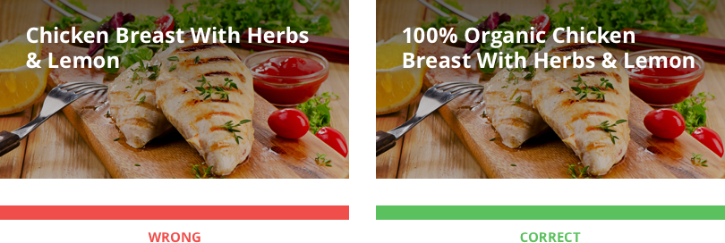
So being honest and transparent about your cost of materials helps.
Restaurant Menu Pricing Methods #1:
Highlight the Inherent Price of Your Food
Highlight the Inherent Price of Your Food
- Menu Engineering Trilogy -

Slide 17
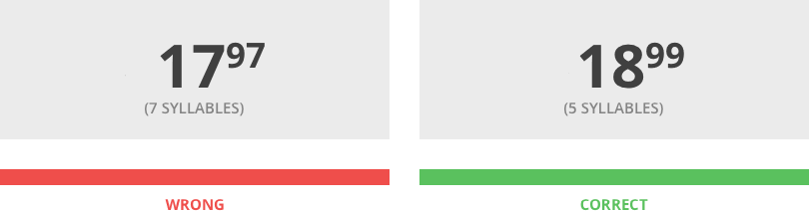
Restaurant Menu Pricing Method #2:
Choose Price Numbers Which Have Fewer Syllables
Coulter, Choi, and Monroe (2012) published a study in the Journal of Consumer Psychology revealing that the auditory version of your price influences price appreciation.
This has to do with a little concept called price magnitude perception, which states that there is a strong link between between syllabic length and numerical magnitude.
The more spoken sounds a price number has, the bigger the price perceived by your customers.
Here’s why: the more syllables a number has, the more mental resources we have to allocate to process that number. And so, we falsely attribute it a bigger magnitude.
However, on the other hand, your customers use less mental resources and perceive prices to be smaller when the numbers they see on the menu in front of them have less syllables.
Menu Engineering Tactic #2:
Choose Price Numbers Which Have Fewer Syllables
- Menu Engineering Trilogy -

Slide 18
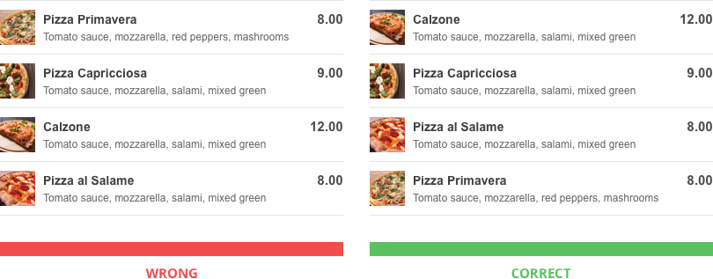
Restaurant Menu Pricing Method #3:
Use Expensive Decoy Food at the Top of the Menu
The cheeky owners have actually used the restaurant menu psychology to deem a new concept, which most menu engineers informally call “decoy dishes”.
What they do is trick their customers into ordering a whole lot of food, by positioning a more expensive food item at the very top of the menu.
Seeing an expensive dish of sea bass seasoned with different herbs and spices and marinated in a fancy sauce - all for $25 - can have quite a powerful impact on the customer.
He’ll actually be inclined to choose some of your other, cheaper dishes, because he’ll get a better value for his money. Or to put informally - he’ll feel that he’ll get more bling for less cha-ching.
And who doesn’t like a great deal? This will also make him feel that can splurge a little and maybe even order some dessert, alongside his main course.
Restaurant Menu Pricing Methods #3:
Use Expensive Decoy Food at the Top of the Menu
- Menu Engineering Trilogy -

Slide 19
Restaurant Menu Pricing Method #4:
Use The Power of Charm Pricing
Using decimals and reducing the left digit of your base number by one (i.e., $20 becomes $19.99) is a common psychology pricing tactic that you can also see it in supermarkets, listed on almost all pricing labels.
The reason why marketers call this “charm pricing” is because it can greatly increase conversion.
However, beware: charm pricing is extremely effective when the left digit of your base number changes.
So, for example, a one-cent difference between $1.99 and $1.98 won’t actually be notable to the customer. However, a one-cent drop between $2 and $1.99 actually turns into a pretty significant difference.
So depending on how you choose to use it, you can become penny wise or penny foolish.
The simple explanation behind it?
It has to do with price magnitude.
Thomas and Morwitz (2005) explain that:
“
“while evaluating “2.99,” the magnitude encoding process starts as soon as our eyes encounter the digit “2.”
- Menu Engineering Trilogy -

Slide 20
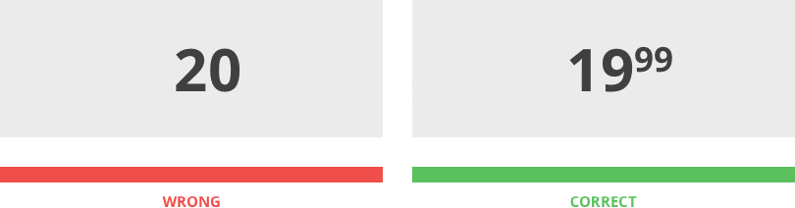
He goes on to say:
“Consequently, the encoded magnitude of $2.99 gets anchored on the leftmost digit (i.e., $2) and becomes significantly lower than the encoded magnitude of $3.00”.
Restaurant Menu Pricing Methods #4:
Use The Power of Charm Pricing
Whether it’s eating out or ordering in, the paying bit is the part that makes us suffer the most. So here’s a nugget of wisdom: what you need to do is remove the focus from your menu prices.
Essentially, this will also help take the spotlight away from the total cost of the food that customers order.
Therefore, to make the most use of the restaurant menu psychology, make sure you hide or delete the currency sign that accompanies your pricing number.
Restaurant Menu Pricing Method #5:
Delete the Currency Sign
- Menu Engineering Trilogy -

Slide 21
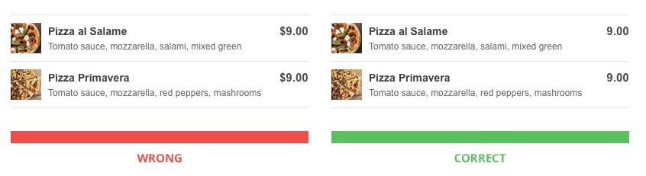
Restaurant Menu Pricing Methods #5:
DELETE The Currency Sign
Charging your customers before actually eating your food is something that benefits both you and your clients.
The main reason for this is because they will be happier with what you deliver to them.
When your clients pay in advance, they focus more on what they do get (so on the benefit of eating good food) than on what they lose (the money in their wallet).
According to Prelec & Lowenstein (1998), getting them to focus on the benefits actually numbs your customers’ fear of losing their money.
So you need to make them looking forward to receiving the food they just ordered and focusing on the positive, instead of intensifying the negative aspect of ordering food.
That would be pretty much like twisting the knife or adding insult to injury. And that is precisely what you’re trying to avoid.
Restaurant Menu Pricing Method #6:
Charge Clients Before Consuming
- Menu Engineering Trilogy -

Slide 22
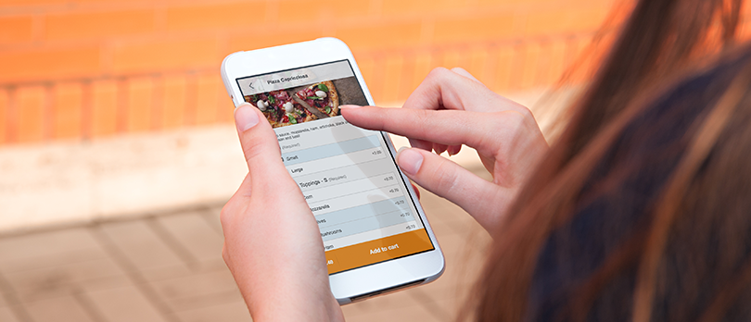
So that’s why having an online ordering system in place and allowing people to pay online actually takes the heat off from having to pay for their food.
Win-win for both you and your customers.
Restaurant Menu Pricing Methods #6:
Charge Clients Before Consuming
These menu pricing tactics are quite possibly the best thing since sliced bread.
And when your friends are going to come by your restaurant and look around, they will be surprised to see a lot of plates sitting on people’s tables. And they won’t be able to stop asking you “how come are these people ordering so much food?”
But don’t worry, we won’t say you’ve used our menu pricing suggestions. In fact, we will let you steal all the glory.
Because your happiness is our bliss.
- Menu Engineering Trilogy -

Slide 23
3 Secret Menu Writing Tips: The BEST Food Descriptions that Make You Hungry
e
PART 3

Slide 24
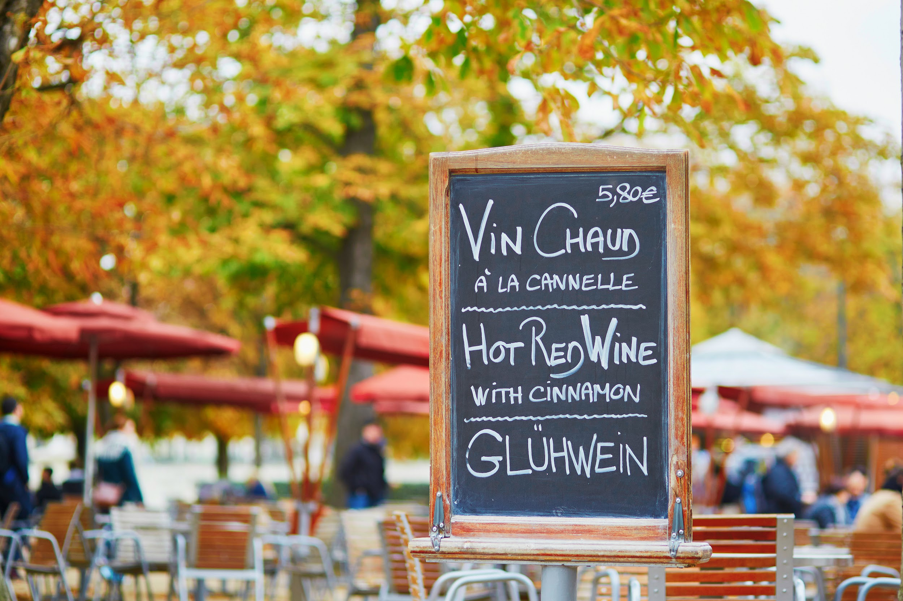
Getting Into Your Client’s Head Using Menu Writing Tips
Do successful restaurateurs rely on menu writing tips & secrets to boost their sales?
Of course they do. It’s not just their delicious food that attracts their clients like moths to a flame.
It’s the way their menu presents their dishes, which also weighs heavy to their restaurant sales.
Did you know that inserting a carefully crafted menu language can lure and bring your clients to you as easily as using fish bait?
Welcome to the third part of the #MenuEngineeringTrilogy, which highlights the persuasion power that language carries.
In fact, there cannot be no trilogy without an article on the fascinating and absorbing art of menu writing that can easily help you hook your clients.
And here’s precisely why.
- Menu Engineering Trilogy -

Slide 25
Menu Descriptions Words that Sell
Words can prove vital to achieving your goal, whatever that may be. Because they can captivate, they can influence, and they can even sell.
That’s why crafty restaurateurs use creative menu wording… since they are powerful enough to trigger their clients’ emotional response. And impel them to order more foods from the menu.
In fact, researchers at Utrecht University, discovered that...
In layman’s terms that means that upon reading appealing restaurant menu descriptions people actually imagine themselves enjoying that tasty food they’re reading about.
So, without further ado let’s skip to the core menu writing ideas YOU should absolutely use in your menu.
How to Write a Menu Description: Follow these 3 Steps
Here’s an important trick of the trade.
Various studies agree with menu engineers in that one of the best ways to keep your clients satisfied and happy is by writing longer food descriptions.
“tempting food words activate simulations of eating the food, including simulations of the taste and texture of the food, simulations of eating situations, and simulations of hedonic enjoyment”
(Papies EK. Tempting food words activate eating simulations. Frontiers in Psychology)
“
Menu Writing Tips #1:
Longer Food Descriptions Sell 30% More Food
- Menu Engineering Trilogy -

Slide 26
Take for instance the following menu descriptions examples: Succulent Italian Seafood Filet” V.S. “Seafood Filet”, which costs, let’s say $13.
The more words you use to name and describe your dishes, the lower the price will seem to your clients. Because they’ll feel that they’ll be getting more for their money. That they’ll be the ones getting a bargain.
A field experiment conducted by Dr. Brian Wansink, the director of the Food and Brand Lab at Cornell University, discovered that using food descriptions words helped boost sales with 27% more than the same name dishes without those extra descriptors.
So try using more of the following menu descriptions words like:
Another great way you can make the most use of this tactic is by adding plenty of ingredients listed under the foods item in your menu.
And get this: according to the same Cornell study, customers also rated the more thoroughly described food as being more delicious. So instead of merely saying “Chocolate cake”, try more something along the lines of…
“5-Layer Chocolate Cake – coffee-bathed chocolate gateau, Belgian chocolate filling, fluffy whipped cream and raspberry icing.”
Bonus tip: providing that the following also apply to your foods, you can also use the following menu writing formulas like:
“gluten-free”,
“line-caught”,
“farm-raised”
or “locally sourced”
… which customers absolutely seem to love.
Adjectives:
“tender,” “succulent,” and “satin”
Cultural/geographic terms:
“Cajun”, “Italian”, “Spanish”, “Peruvian”;
Nostalgic terms like…
“homestyle,” “traditional,” & “Grandma’s”
- Menu Engineering Trilogy -

Slide 27
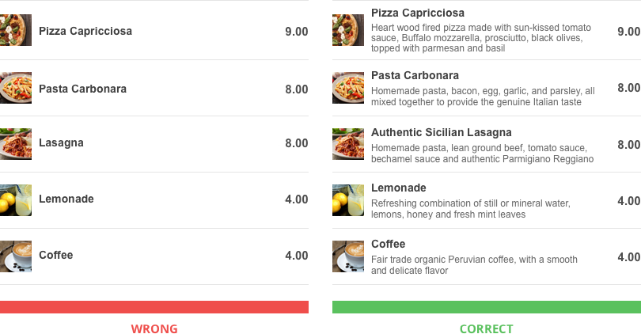
So the best way to give your clients a run for their money? Writing a longer description of the menu item.
Menu Writing Tips #1:
Longer Food Descriptions Sell 30% More Food
A nostalgic blast from the past can really help you go a long way with your clients. And as long as you’re using the power of emotional names for your dishes, you can only win.
For example, instead of simply writing “Lasagna” or “Wedges”, on your menu, you can go big and use the following menu writing samples:
“Grandma’s Lasagna Recipe”
“Traditional Sicilian Wedges”
Menu Writing Tips #2:
Use Nostalgia / Emotionally Charged Language to Describe Your Dishes
Or
- Menu Engineering Trilogy -

Slide 28
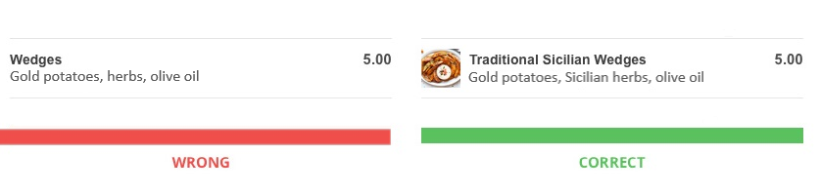
Coming up with creative ways of reminding them about the things they care about the most is essentially a powerful selling method in itself.
What you should always remember is that people make buying decisions based on their emotions, yet they justify it with logic and reason.
Menu Writing Tips #2:
Use Nostalgia / Emotionally Charged Language to Describe Your Dishes
Persuasion is strongly related to lexical diversity. What does that mean?
Well, Hosman (2002) discovered that people get persuaded more easily as long as the text they’re seeing or the speech they’re hearing contains a variety of synonyms.
Hosman highlights the importance of using this concept, called type-token ratio or TTR.
TTR is an indicator that can be calculated using the following formula:
Type-Token Ratio = No. of Different Words / Total No. of Words
Menu Writing Tips #3:
Maximize the Diversity of Your Word Choices
- Menu Engineering Trilogy -

Slide 29
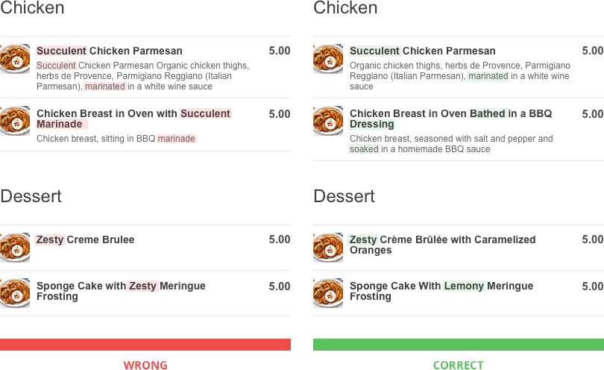
And the higher the TTR number, the better, because your clients will perceive messages with a bigger TTR to be more interesting.
And they will assess them more favorably.
However, make sure you’re only sticking to using simple words, instead of more fancier words that might confuse your clients.
Here’s the best way you can see how easy to understand your menu is: read it to a 7-year old. Or at least put yourself in the shoes of a 7-year-old. I’m not joking.
Some of the biggest copywriters in history use the same method. Because that is honestly the easiest way to make sure that everyone finds your menu irresistible.
So make sure you’re using different, yet simple words to best describe your dishes.
Menu Writing Tips #3:
Maximize the Diversity of Your Word Choices
“
“A low TTR means that a speaker’s vocabulary is relatively redundant, while a high TTR means that it is relatively diverse.”
(Hosman, 2002, pp. 374)
“
- Menu Engineering Trilogy -

